Slide 1

Programing Clinic
Vehicle management
reporting person：Duan Youzhen
reporting time：09.06.2024
Notes:
模板来自于： 第一PPT https://www.1ppt.com/

Slide 2
Project ideas
Basic event flow：
The traffic department wants to automate the process of detecting traffic violations, such as speeding, illegal parking or running red lights. Once a violation is detected, the system should issue a ticket to the vehicle owner based on the type of violation.
Notes:
模板来自于： 第一PPT https://www.1ppt.com/

Slide 3
Project ideas
Suggested methodology：
Implement procedures to detect different types of traffic violations
Automatically impose fines based on the type and severity of the violation.
Key point: The system should distinguish between different types of violations and have different configurable actions for each type. Consider implementing functionality to notify vehicle owners via email, assuming that email addresses exist in a given dataset.
Notes:
模板来自于： 第一PPT https://www.1ppt.com/

Slide 4
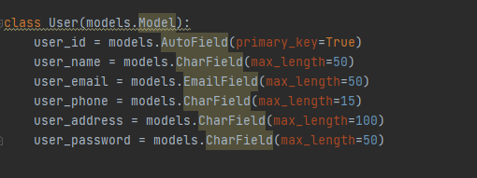
1. Owner model add use_credit
Notes:
模板来自于： 第一PPT https://www.1ppt.com/

Slide 5
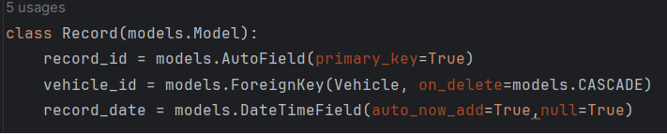
2. Modify the model of registered licence plate number
Notes:
模板来自于： 第一PPT https://www.1ppt.com/

Slide 6
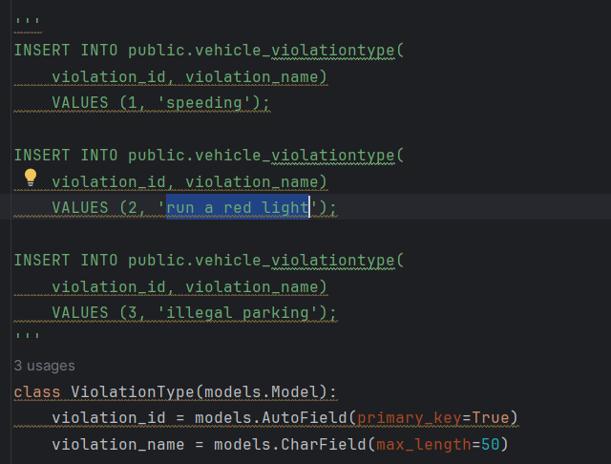
3.Modelling of violation types
Notes:
模板来自于： 第一PPT https://www.1ppt.com/

Slide 7
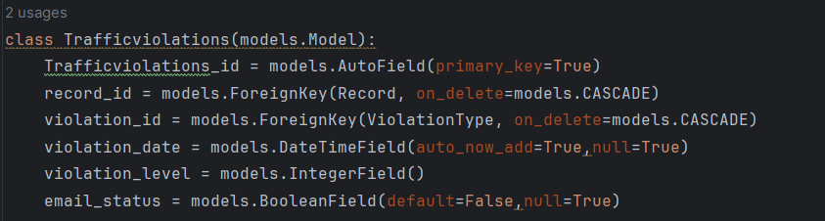
4. Modelling of violations
Notes:
模板来自于： 第一PPT https://www.1ppt.com/

Slide 8
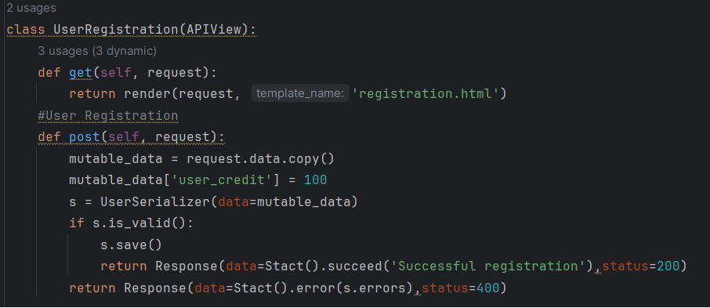
5. Add Owner
Notes:
模板来自于： 第一PPT https://www.1ppt.com/

Slide 9
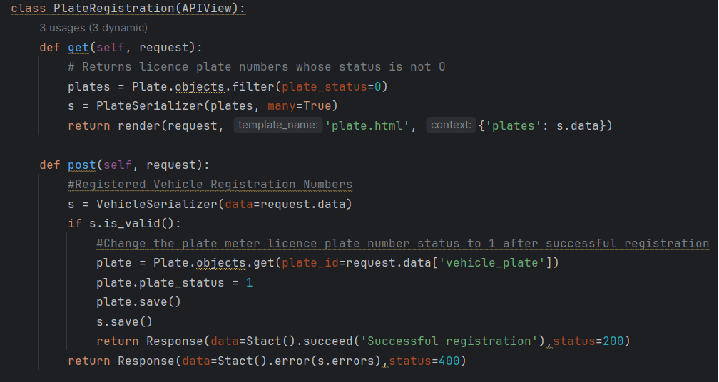
6. Registering a car registration number, entering the
owner's number and selecting a car registration number
Notes:
模板来自于： 第一PPT https://www.1ppt.com/

Slide 10
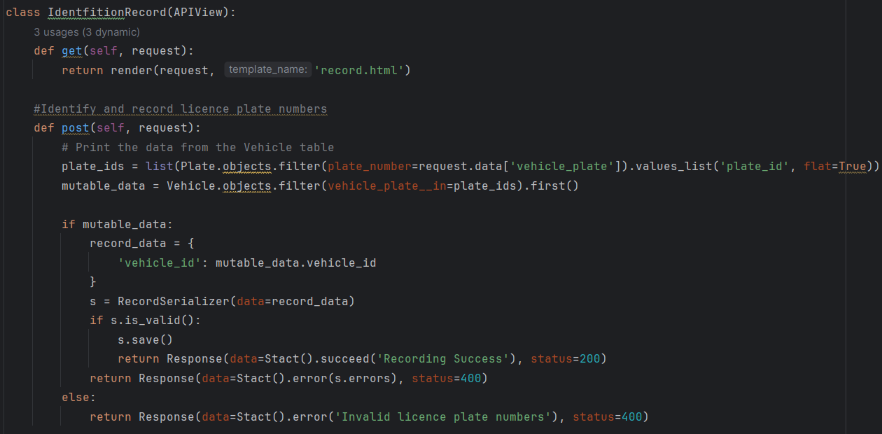
7. Record the licence plate number, record the
owner and licence plate number and the current time
Notes:
模板来自于： 第一PPT https://www.1ppt.com/

Slide 11
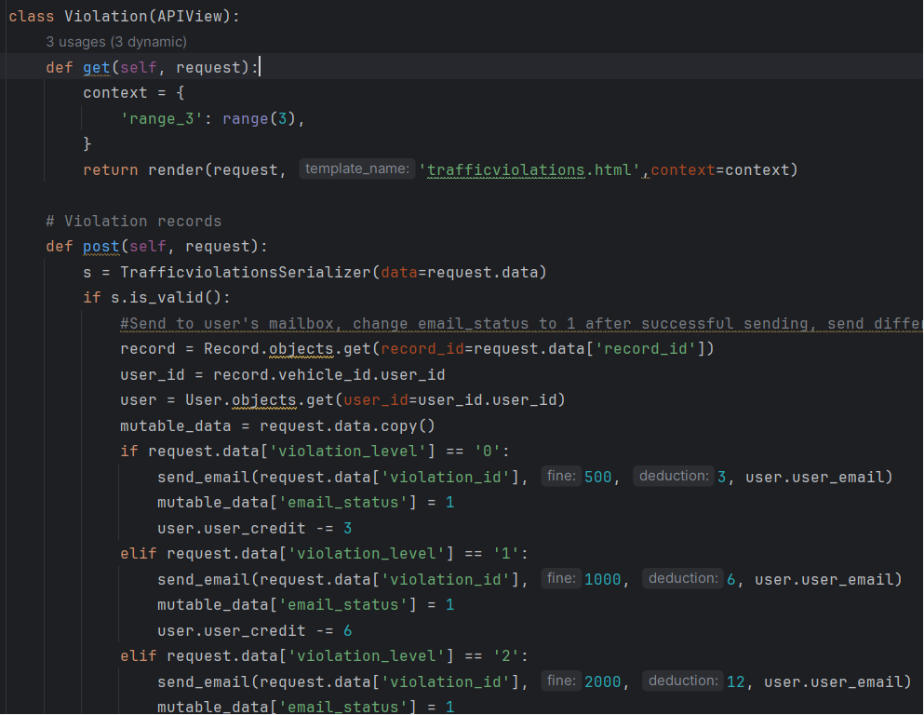
8. Add violation records, according to the violation level of punishment
Notes:
模板来自于： 第一PPT https://www.1ppt.com/

Slide 12
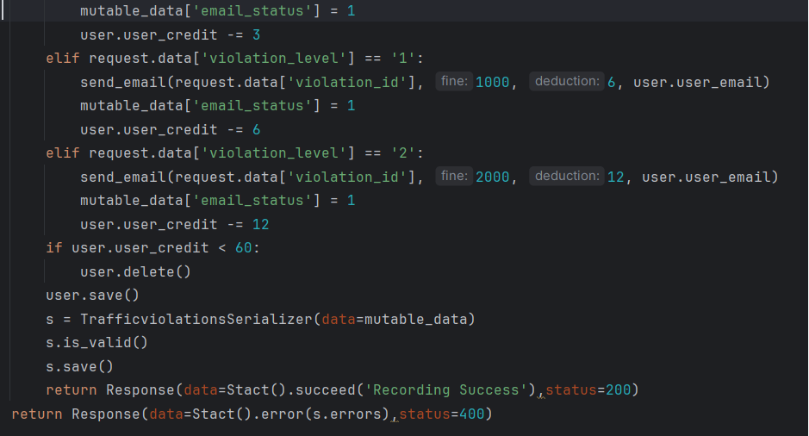
8. Add violation records, according to the violation level of punishment
Notes:
模板来自于： 第一PPT https://www.1ppt.com/

Slide 13
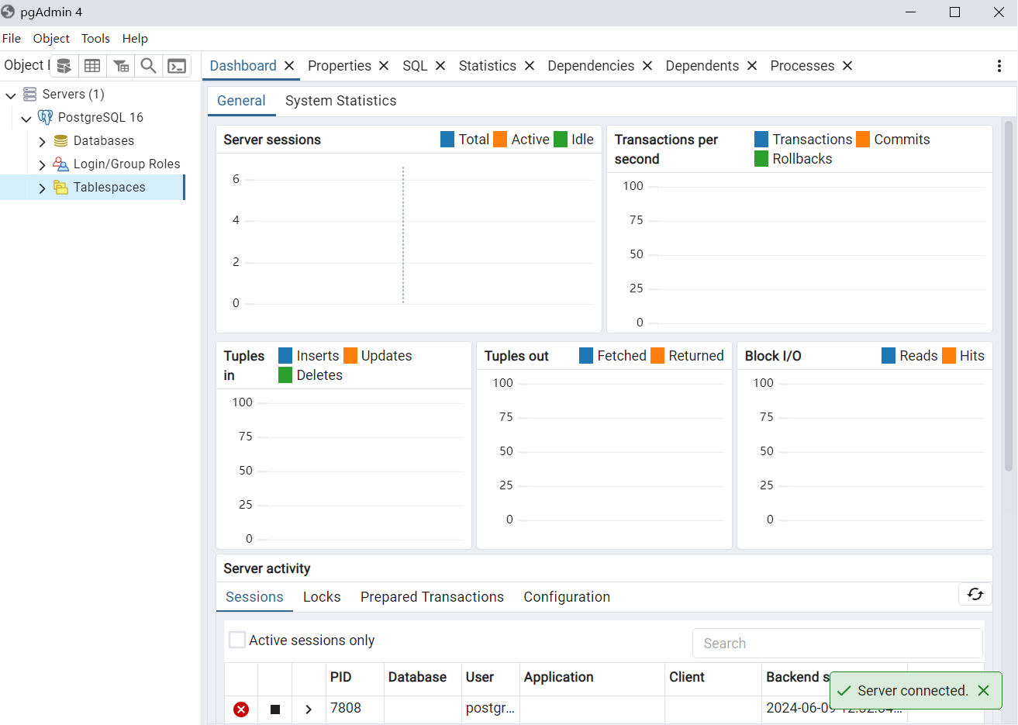
9.Test
-Download and install posterSQL and verify the installation
Notes:
模板来自于： 第一PPT https://www.1ppt.com/

Slide 14
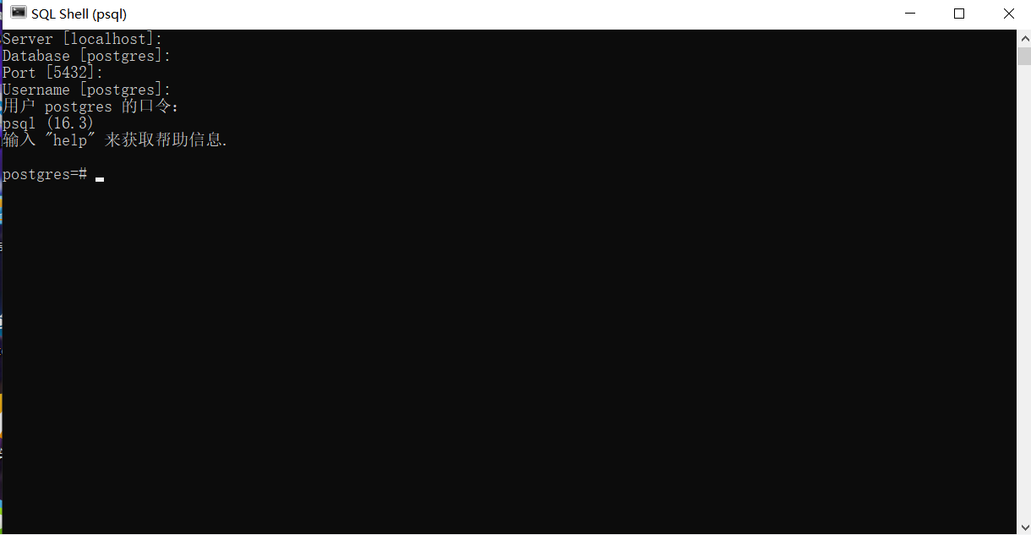
9.Test
-Download and install posterSQL and verify the installation
Notes:
模板来自于： 第一PPT https://www.1ppt.com/

Slide 15
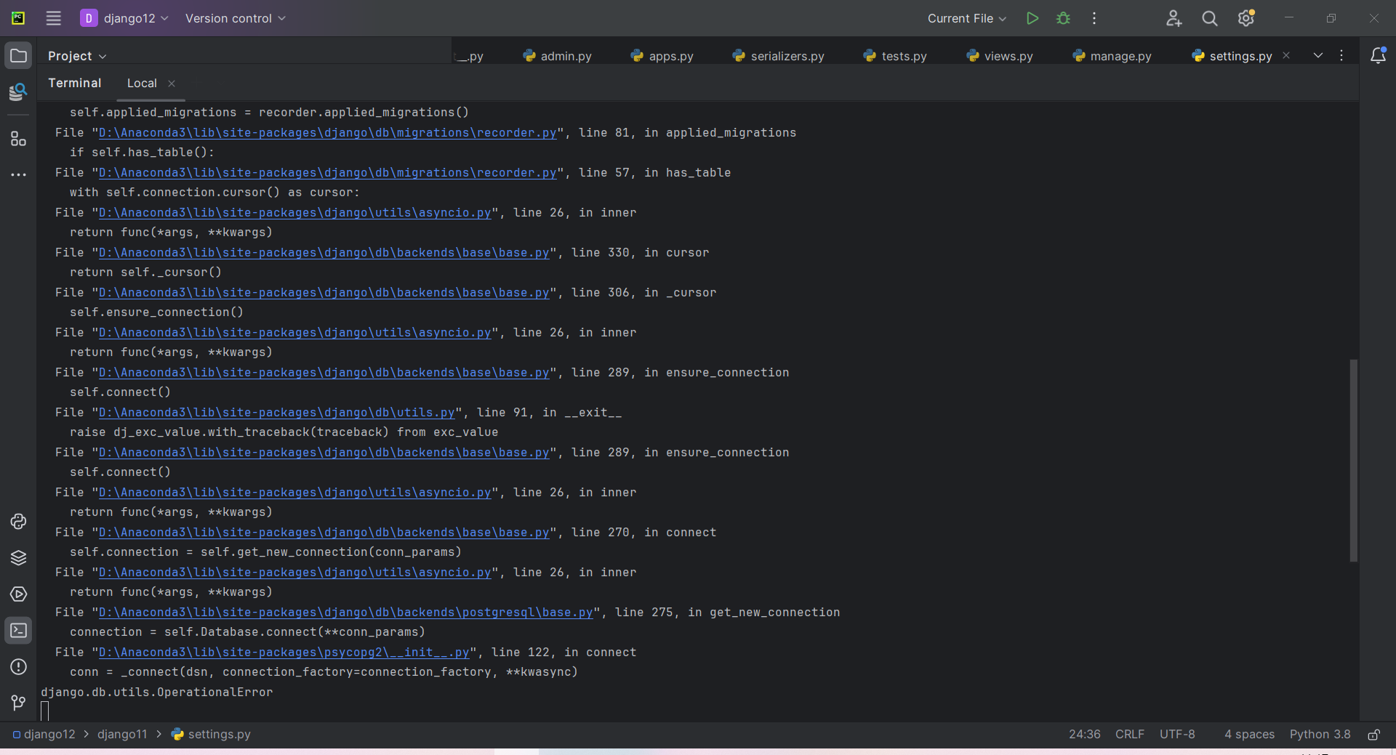
-Problem-
The reason for the error is probably a database connection problem.
Notes:
模板来自于： 第一PPT https://www.1ppt.com/

Slide 16
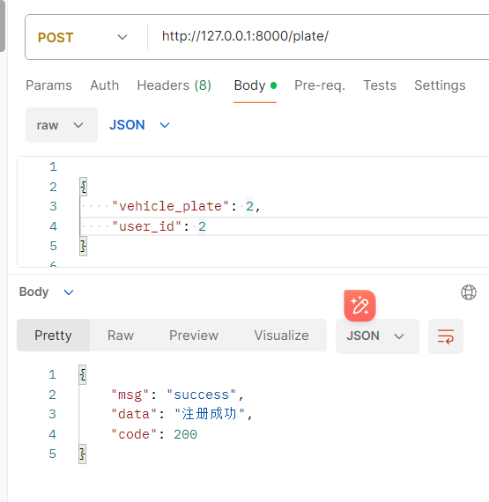
-Registration of licence plate number
-Post Write the licence plate number and owner of the car
Notes:
模板来自于： 第一PPT https://www.1ppt.com/

Slide 17
Thanks for watching.

